Slide 1
Computer lab Vegetation catastrophes
Hanna ten Brink
30 September 2025

Slide 2
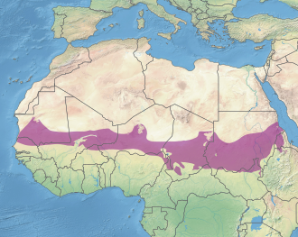
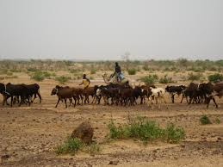
Introduction
Rietkerk, M., Van Den Bosch, F., & Van De Koppel, J. (1997). Site-Specific Properties and Irreversible Vegetation Changes in Semi-Arid Grazing Systems. Oikos, 80(2), 241. https://doi.org/10.2307/3546592
Notes:
Transition savannah and desert
At border growth limited by water, but soil high water infiltration
Model of plant density (P), and soil water (W).

Slide 3
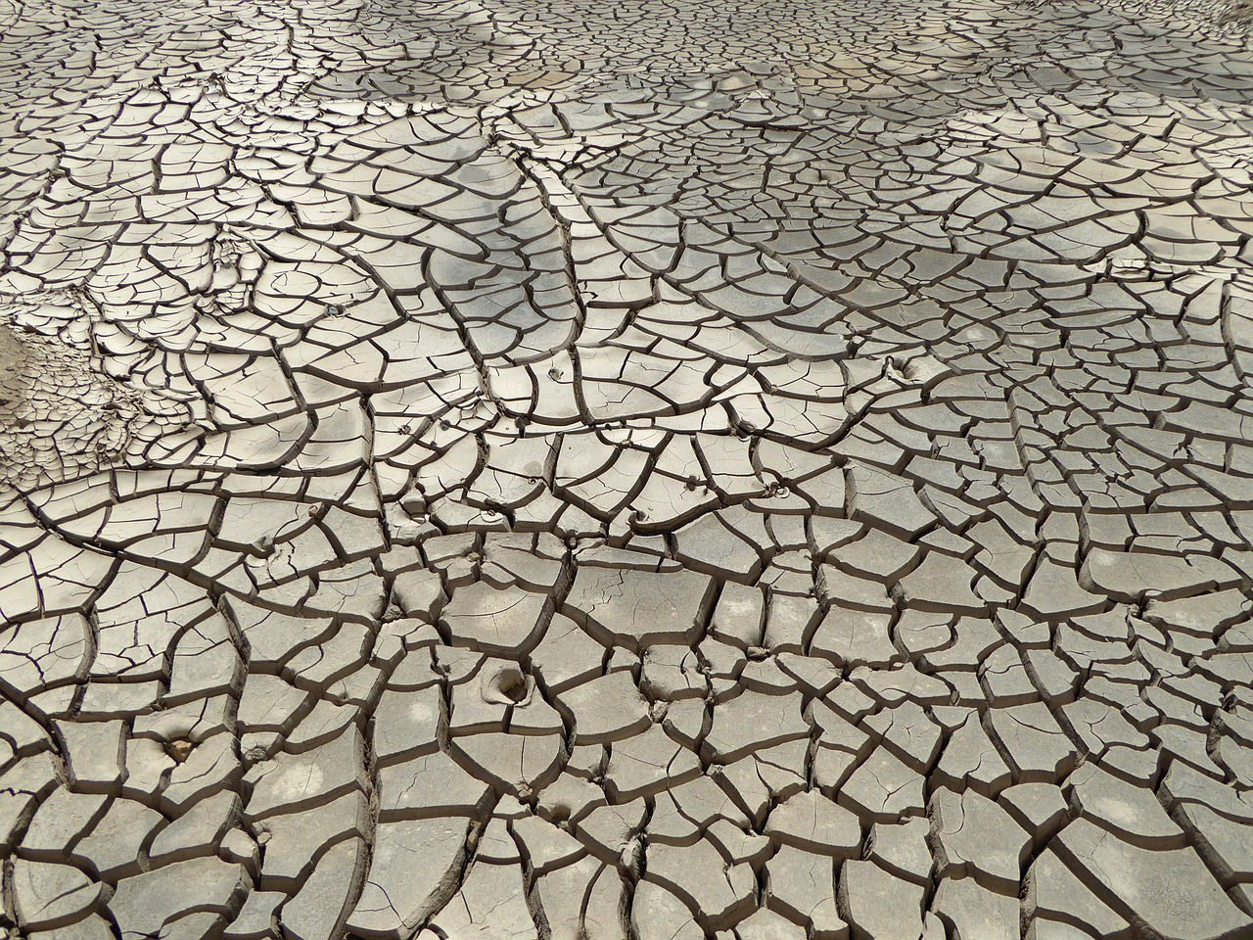
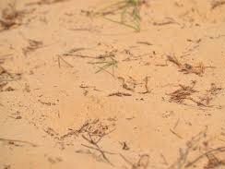
Water infiltration in the absence of plants depends on soil type

Slide 4

Model
$$\frac{dW}{dt}=R\frac{P+k_{2}W_{0}}{P+k_{2}}−c_{\text{max}}\frac{W}{W+k_{1}}P−r_{w}W$$
$$\frac{dP}{dt}= g_{\text{max}}\frac{W}{W+k_{1}}P−dP −bP$$

Slide 5
Model
Water infiltration
$$\frac{dW}{dt}=R\frac{P+k_{2}W_{0}}{P+k_{2}}−c_{\text{max}}\frac{W}{W+k_{1}}P−r_{w}W$$
$$\frac{dP}{dt}= g_{\text{max}}\frac{W}{W+k_{1}}P−dP −bP$$

Slide 6
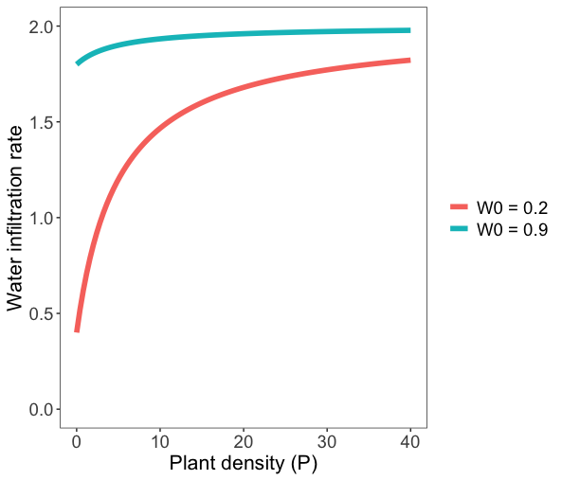

Plot of water infiltration
$$R\frac{P+k_{2}W_{0}}{P+k_{2}}$$

Slide 7
Model
Water infiltration
Plant growth
$$\frac{dW}{dt}=R\frac{P+k_{2}W_{0}}{P+k_{2}}−c_{\text{max}}\frac{W}{W+k_{1}}P−r_{w}W$$
$$\frac{dP}{dt}= g_{\text{max}}\frac{W}{W+k_{1}}P−dP −bP$$
Water uptake by plants
Background mortality
Water loss due to respiration
Grazing mortality

Slide 8
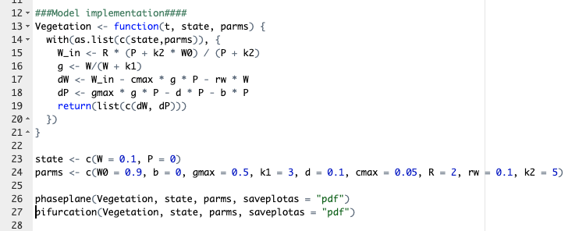
Model implementation

Slide 9
Isoclines and timeseries for high water infiltration
b = 0
b = 0.1
b = 0.34

Slide 10
Bifurcation over grazing when water infiltration is high
W0 = 0.9

Slide 11
Bifurcation over grazing when water infiltration is high
W0 = 0.9

Slide 12
Bifurcation over grazing when water infiltration is high
W0 = 0.9

Slide 13
Isoclines for low water infiltration
b = 0

Slide 14
Isoclines for low water infiltration and grazing
b = 0.27

Slide 15
Timeseries for low water infiltration and grazing
b = 0.27
W0 = 0.2

Slide 16
Bifurcation over grazing when water infiltration is low
W0 = 0.2

Slide 17
Bifurcation over grazing when water infiltration is low
W0 = 0.2

Slide 18
Two-parameter plot

Slide 19
Two-parameter plot
Persistence of plants
No plants
Bistability

Slide 20
Two-parameter plot
Persistence of plants
No plants
Bistability

Slide 21
Two-parameter plot
Persistence of plants
No plants
Bistability

Slide 22
Challenge: Sketch a bifurcation over W0 for b = 0.1 You can use the computer to check
Persistence of plants
No plants
Bistability

Slide 23
Challenge: Sketch a bifurcation over W0 for b = 0.1 You can use the computer to check
Persistence of plants
No plants
Bistability

Slide 24
Challenge: Sketch a bifurcation over W0 for b = 0.3 You can use the computer to check
Persistence of plants
No plants
Bistability

Slide 25
Challenge: Sketch a bifurcation over W0 for b = 0.3 You can use the computer to check
Persistence of plants
No plants
Bistability

Slide 26
Challenge: Sketch a bifurcation over W0 for b = 0.33 You can use the computer to check
Persistence of plants
No plants
Bistability

Slide 27
Challenge: Sketch a bifurcation over W0 for b = 0.33 You can use the computer to check
Persistence of plants
No plants
Bistability

